Slide 1

OOPM-IA-2
TOPIC:
LIBRARY
MANAGMENT
SYSTEM
AAKRITI MEHTA - 16010122109
KHUSHI MENPARA - 16010122118

Slide 2
PROBLEM STATEMENT :
A library management system is essential to efficiently organize and manage the vast collection of books A Library Management System (LMS) implemented in Java , comprising several classes such as Admin, Book , BookDatabase , Library , Reader , and Account . Upon registering in library , new users’ accounts are created. For existing users, the system promts them to specify their role as either an “ADMIN” or a “READER”. If the user selects the “ADMIN” role, they are granted privileges to add or delete books from the library’s database. If the user selects the “READER” role, they gain access to functionalities allowing them to issue and return books from the library’s collection. Users have the option to log out when they have completed their tasks, and they can exit the system .

Slide 3
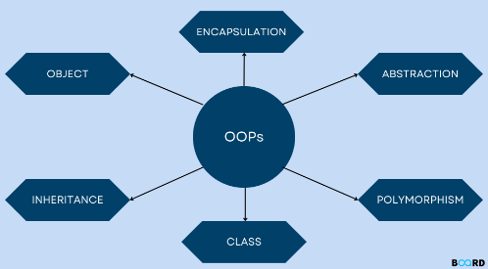
CLASS DIAGRAM
WHAT IS CLASS DIAGRAM ????
The class diagram is the main building block of object-oriented modeling. It is used for general conceptual modeling of the structure of the application, and for detailed modeling, translating the models into programming code. Class diagrams can also be used for data modeling.

Slide 4
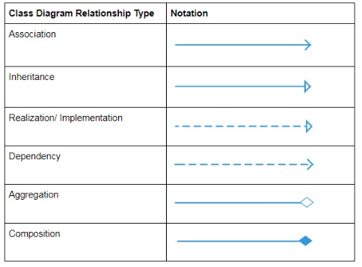
Association:
An association class is a class that is part of an association relationship between two other classes. You can attach an association class to an association relationship to provide additional information about the relationship.
Inheritance:
The process of a child or sub-class taking on the functionality of a parent or superclass, also known as generalization. It's symbolized with a straight connected line with a closed arrowhead pointing towards the superclass.
Realization:
A realization is a relationship between classes, interfaces, components and packages that connects a client element with a supplier element.
Dependency:
An object of one class might use an object of another class in the code of a method. If the object is not stored in any field, then this is modeled as a dependency relationship.
Aggregation:
Aggregation can occur when a class is a collection or container of other classes, but the contained classes do not have a strong lifecycle dependency on the container.
Composition:
It's a composition if one parent class object owns another child class object and that child class object cannot meaningfully exist without the parent class object. If it can then it is called Aggregation.

Slide 5
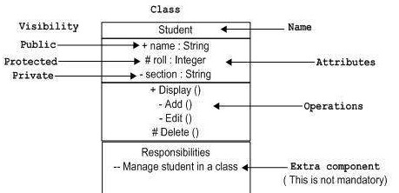
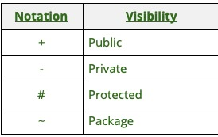
IMPORTANT LABELLING
IN
CLASS DIAGRAM

Slide 6
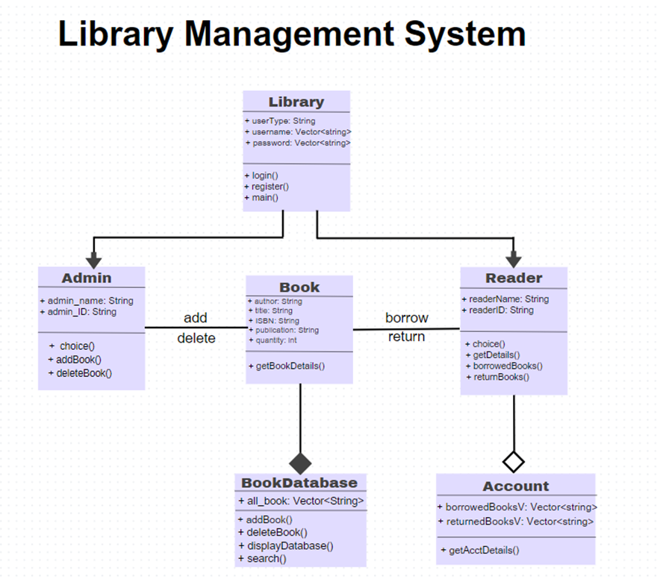
CLASS DIAGRAM

Slide 7
Algorithm:
1. Start
2. The user is given a menu to :
a. Login: If an existing user if valid, the user needs to enter credentials. If the credentials are invalid step 2 is repeated, else control moves to step 3 or 4 depending on whether user is admin or reader respectively.
b. Register: If a new user wants to register, they need to enter credentials and they are stored. Control moves to step 2 again.
c. Exit: program is terminated, control is passed to step 5
3. The admin is provided with a menu:
a. Add book to database: the admin is allowed to add details of a book to the book database
b. Delete book from database: the admin is allowed to delete a book from the book database
c. Display database: the entire book database is displayed
d. Logout: the control moves to step 2
e. Exit: the program is terminated, control is passed to step 5
4. The reader is provided with a menu
a. Borrow book: the reader borrows a book if available
b. Return book: the book the reader if had issued is returned to the database
c. Get Account details: the details of the reader is displayed d. Logout: the control moves to step 2
e. Exit: the program is terminated, control is passed to step 5
5. End

Slide 8
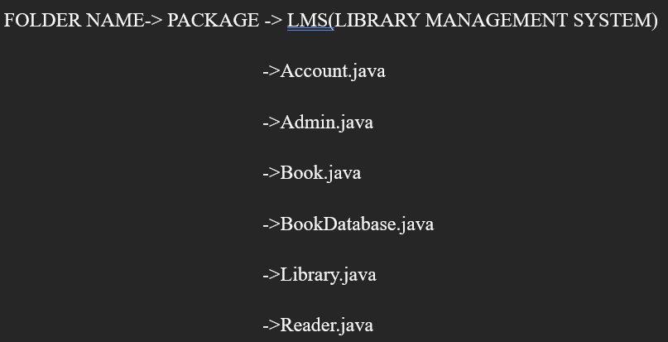
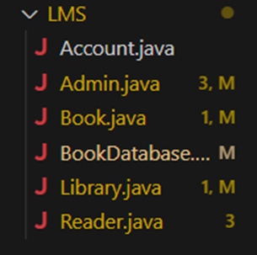
Implementation details:

Slide 9
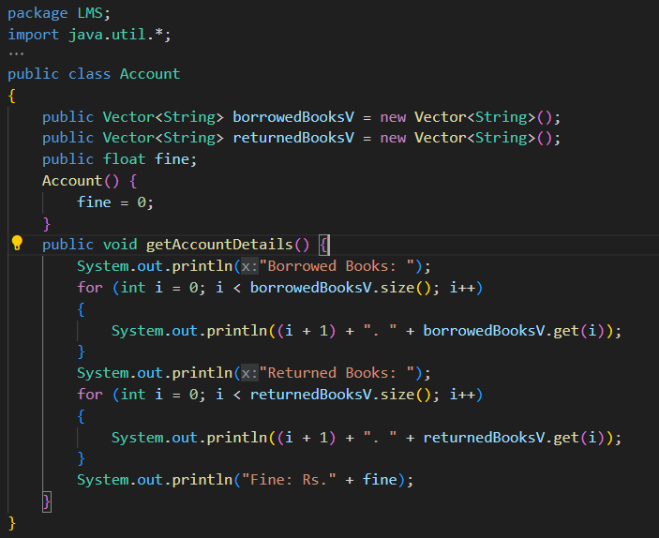
Account.java

Slide 10
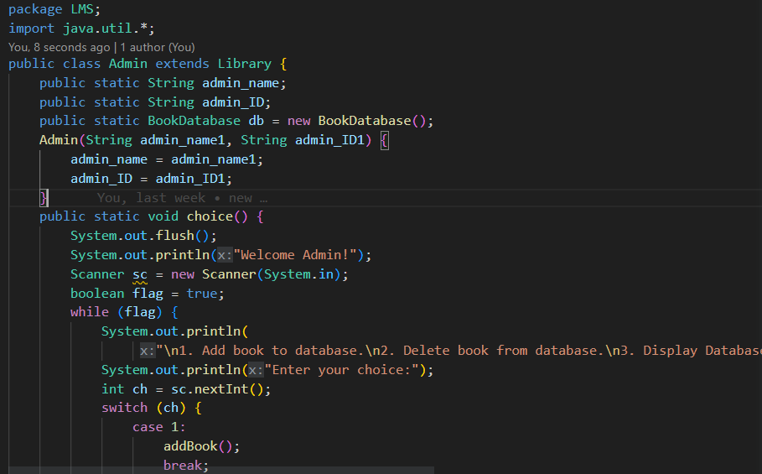
Admin.java
"\n1. Add book to database.\n2. Delete book from database.\n3. Display Database\n4. Logout\n5. Exit");

Slide 11
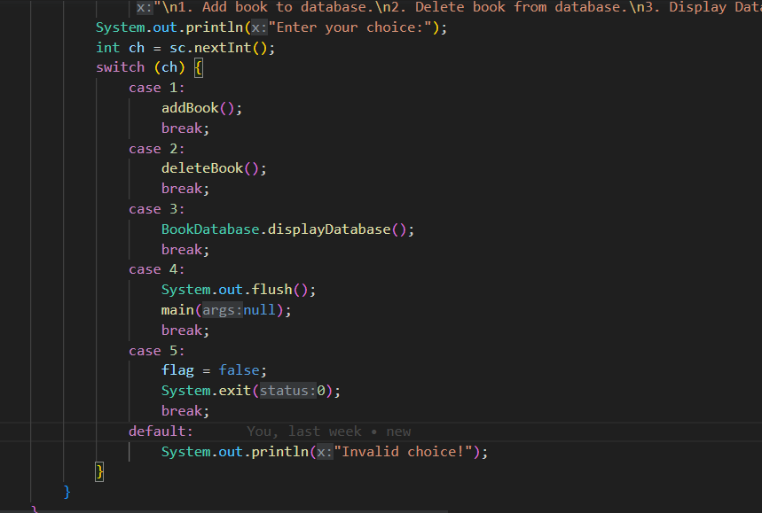

Slide 12
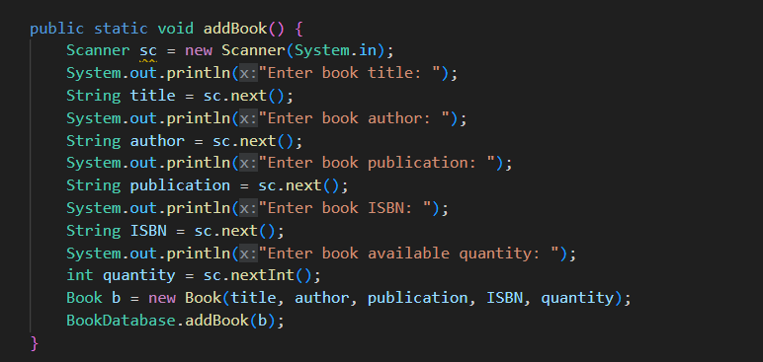

Slide 13
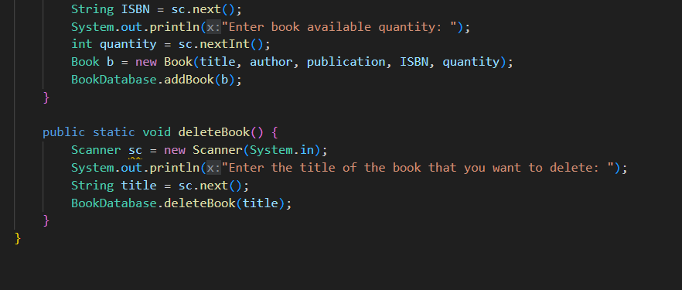

Slide 14
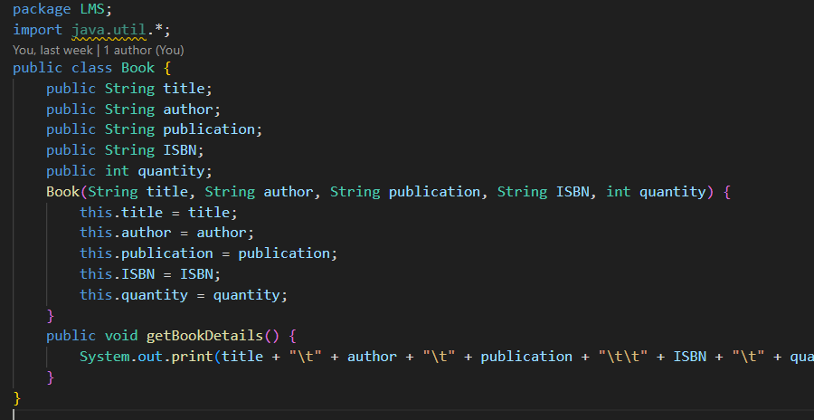
Book.java
title + "\t" + author + "\t" + publication + "\t\t" + ISBN + "\t" + quantity + "\t");

Slide 15
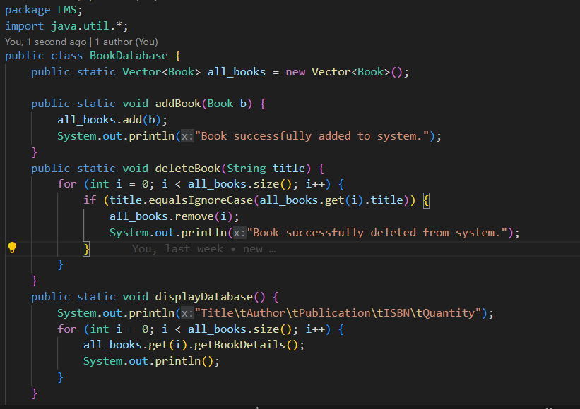
BookDatabase.java

Slide 16
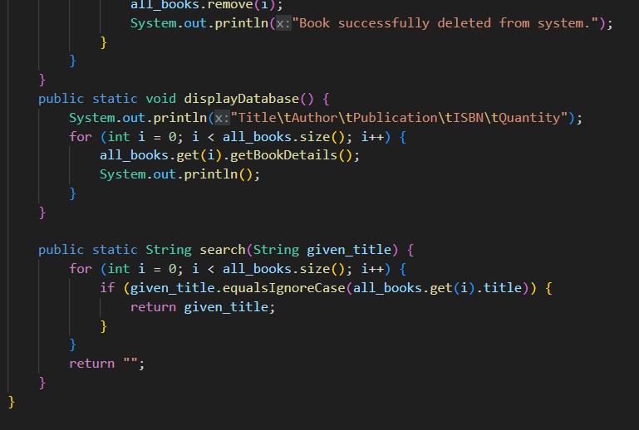

Slide 17
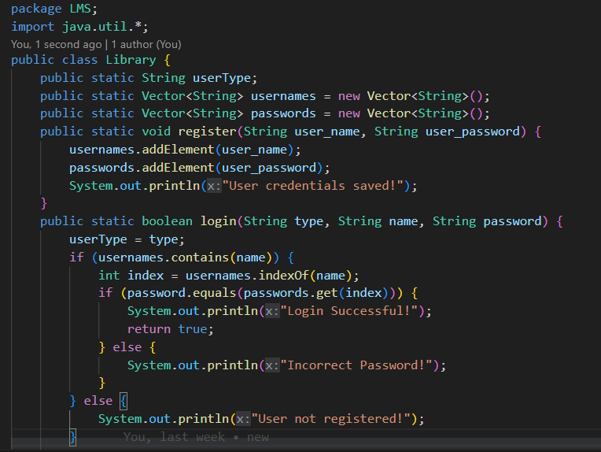
Library.java

Slide 18
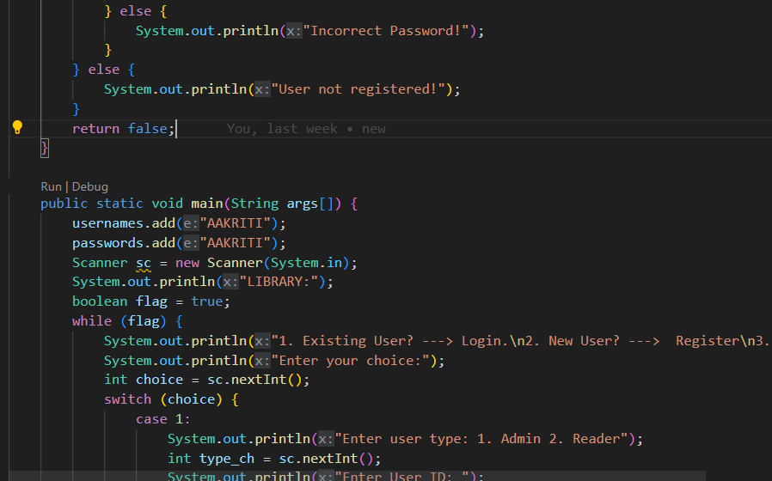

Slide 19
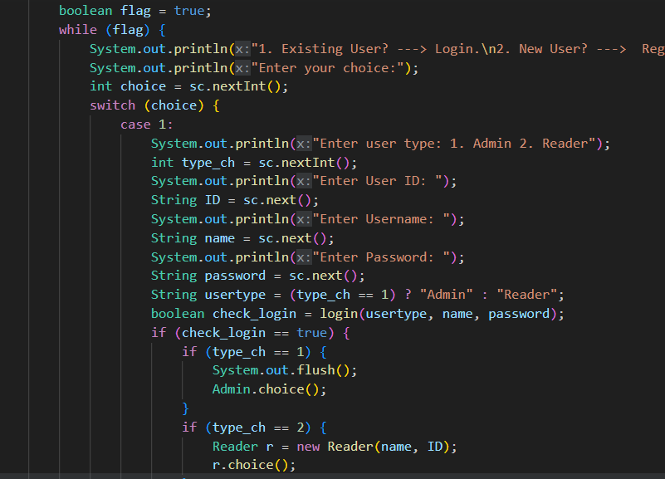

Slide 20
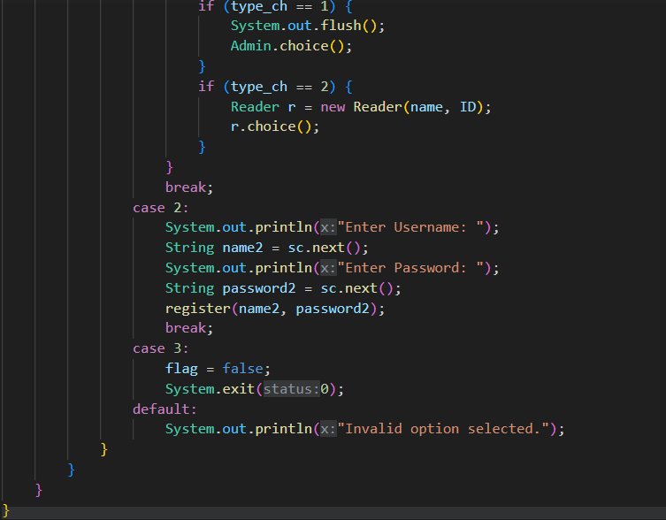

Slide 21
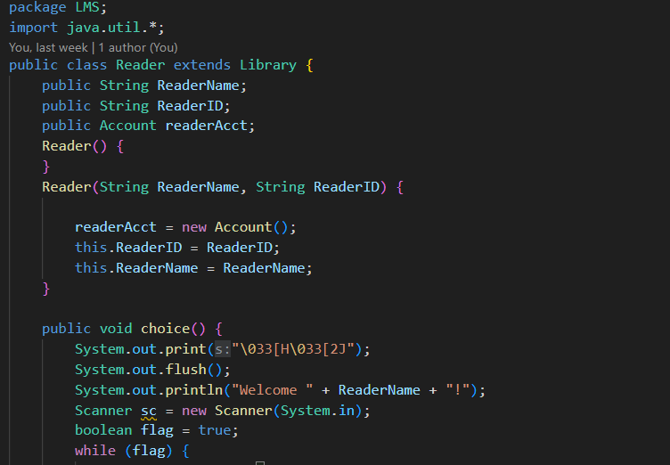
Reader.java

Slide 22
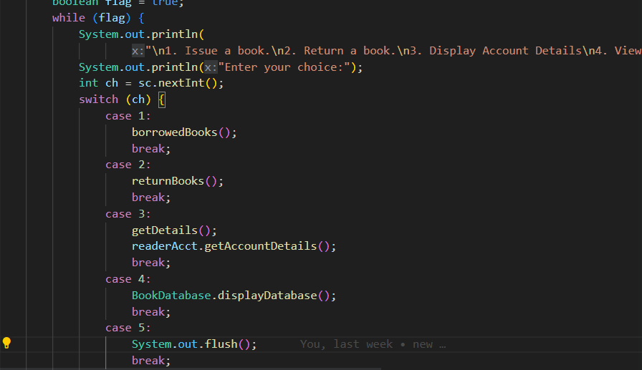

Slide 23
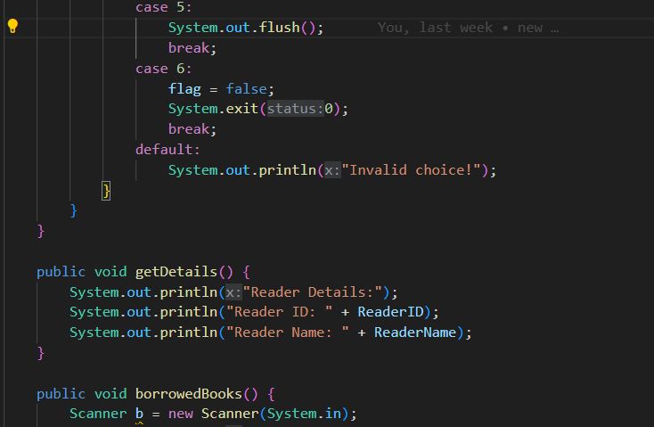

Slide 24
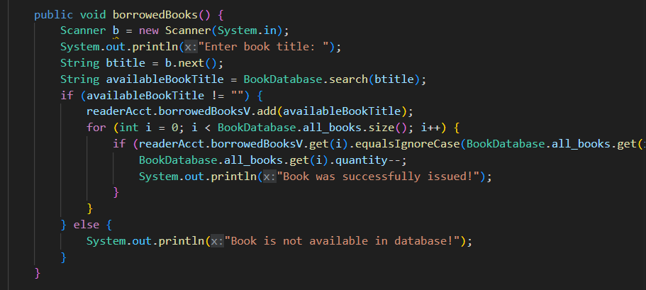

Slide 25
TEST CASES:
Test Case 1- User Registration and Login:
Successful user registration.
Failed registration with an existing username.
Successful login with correct credentials.
Failed login with incorrect password.
Failed login with a non-registered username.
Test Case 2- Admin Functionality:
Add a new book to the database.
Delete a book from the database.
View the entire book database.
Logout successfully as an admin.
Test Case 3 - Security:
Validate that user passwords are stored securely

Slide 26
Test Case 4- Reader Functionality :
Issue a book successfully.
Attempt to issue a non-existent book.
Return a book successfully.
Attempt to return a book that was not borrowed.
View the book database as a reader.
View account details as a reader.
Test Case 5 - Data:
Ensure that the book quantity is updated correctly when a book is borrowed or returned.
Test Case 6 - Error Handling:
Verify that appropriate error messages are displayed when an error occurs, such as attempting to borrow a non-existent book.
Test Case 7 - User Experience:
Evaluate the user interface for readability and user-friendliness. Ensure it provides clear instructions and feedback.

Slide 27
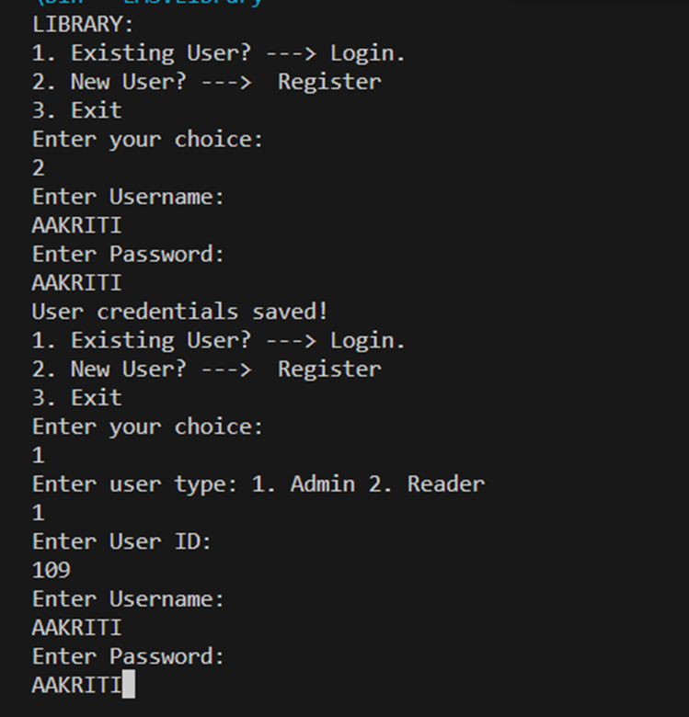
OUTPUT:

Slide 28
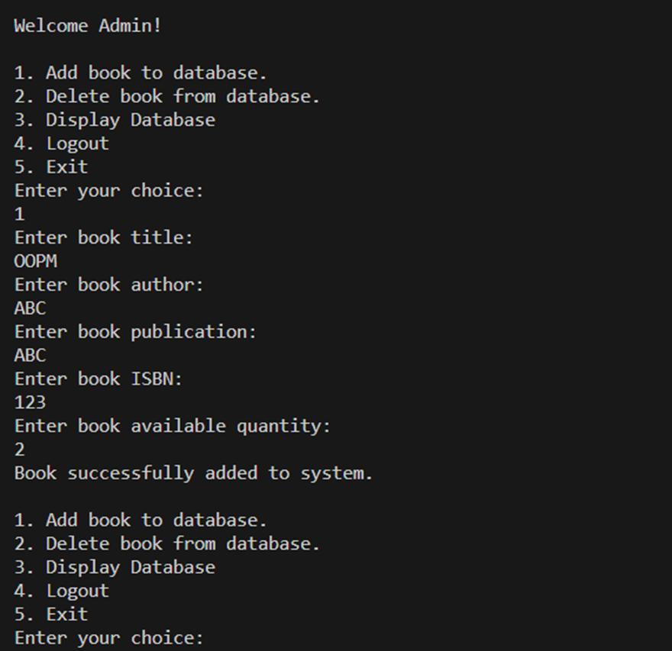

Slide 29
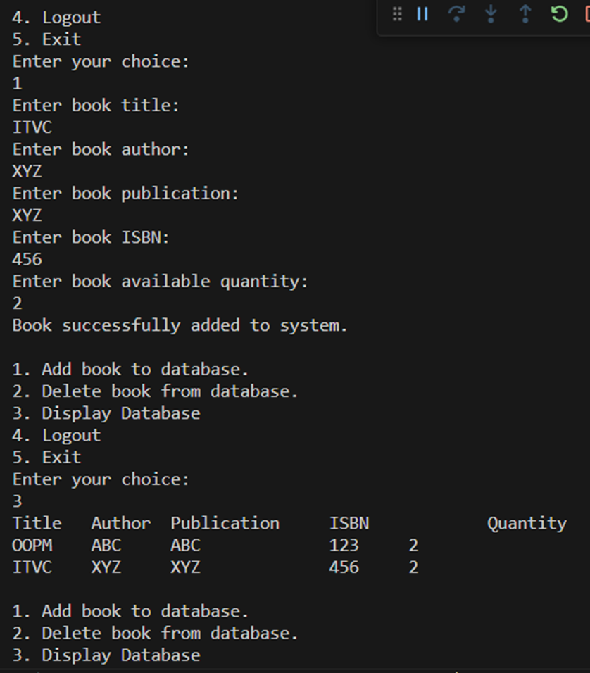

Slide 30
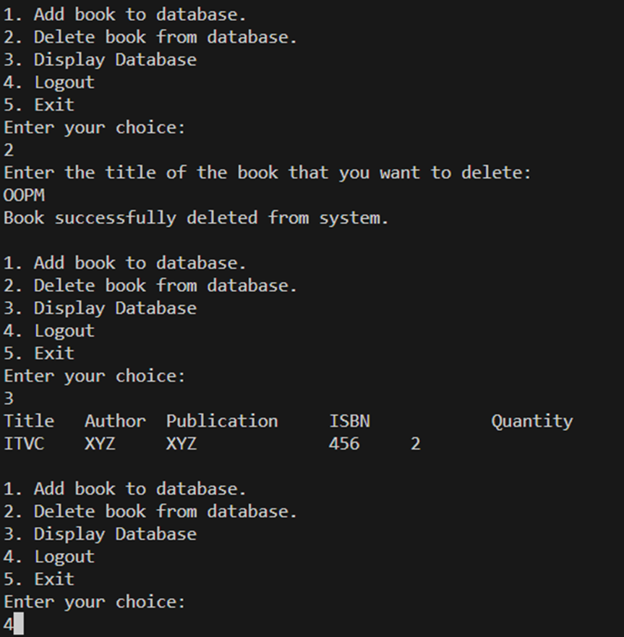

Slide 31
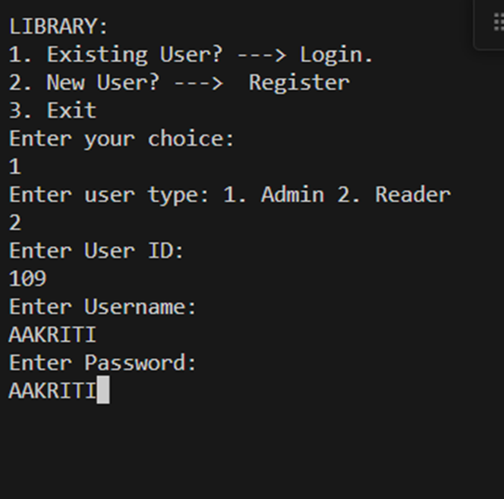

Slide 32
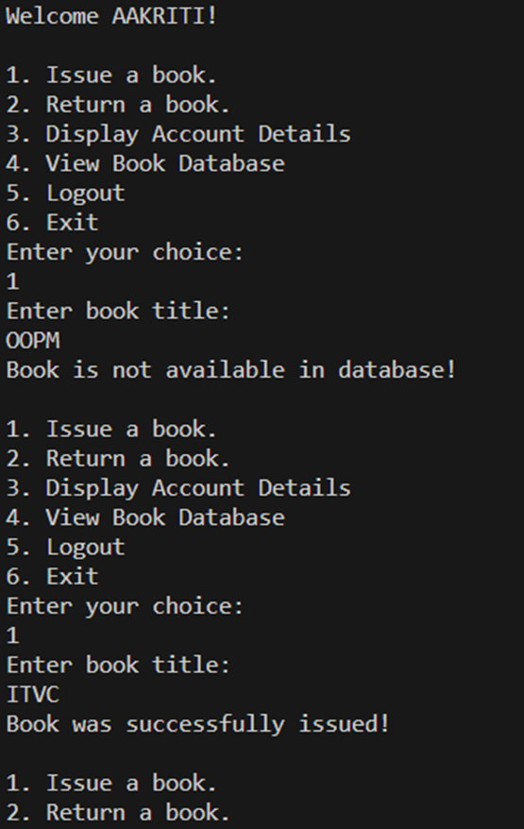

Slide 33
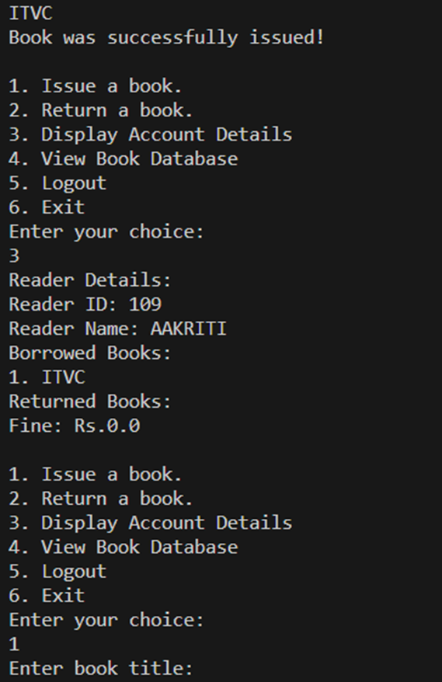

Slide 34
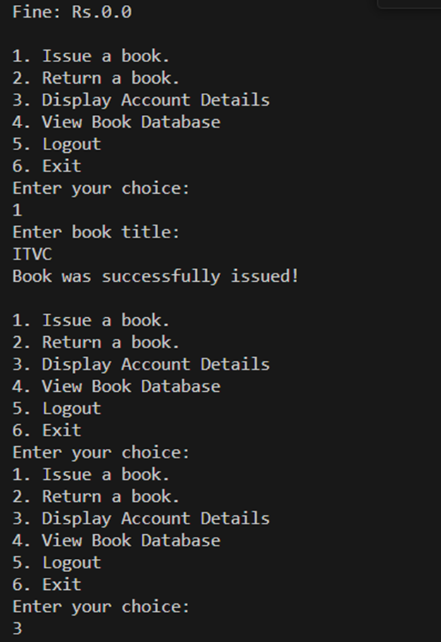

Slide 35
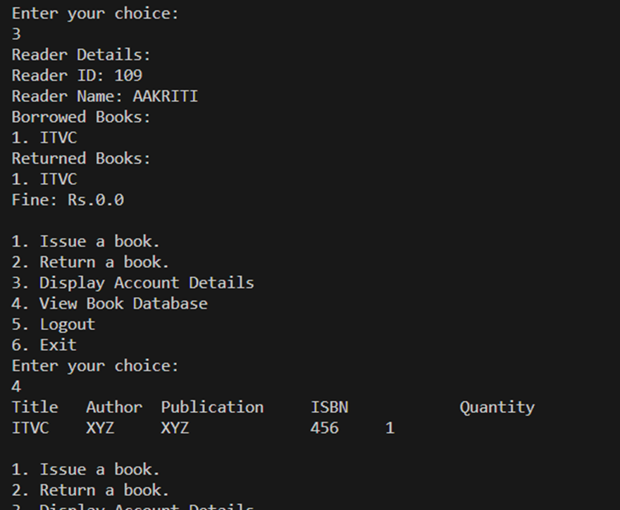

Slide 36
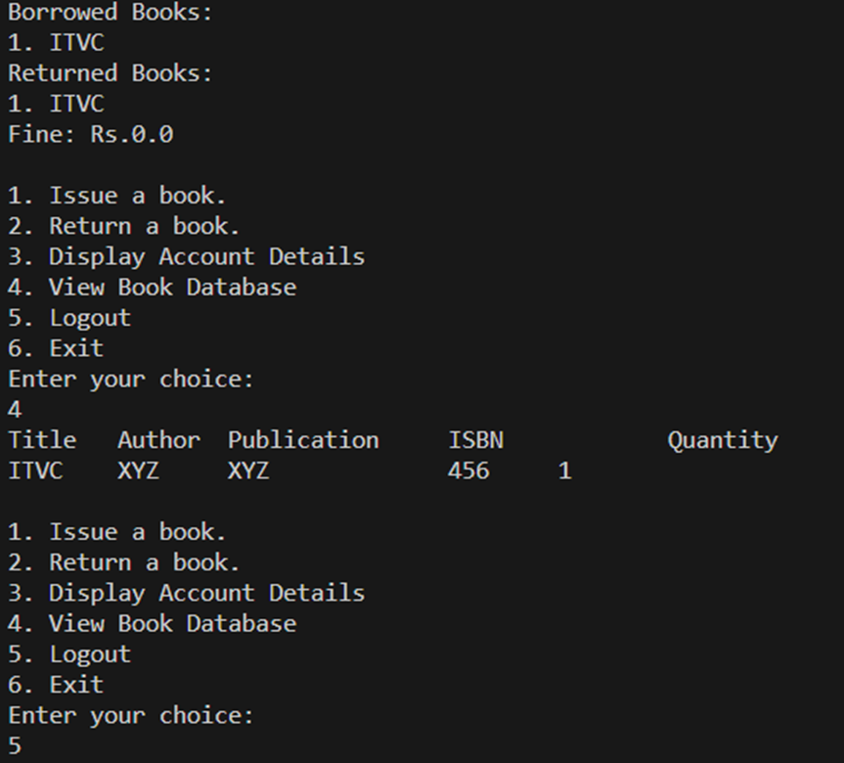

Slide 37
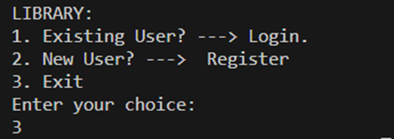

Slide 38
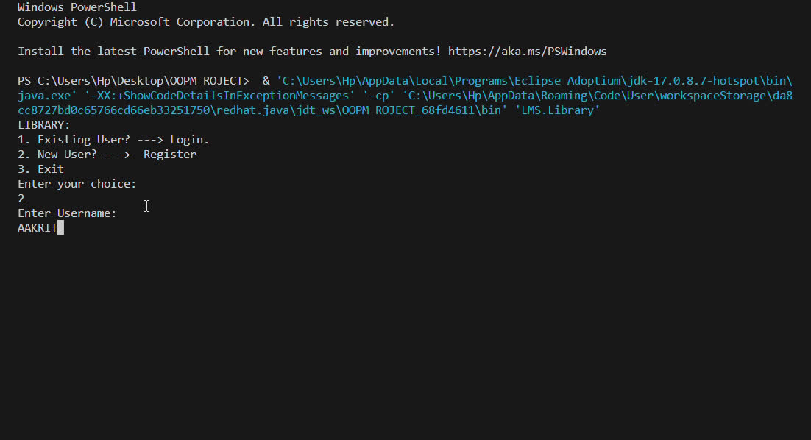

Slide 39


